Slide 1
Statistical Optimal Hash-based Longest Prefix Match
Authors: | Yi Wang, Zhuyun Qi, Huichen Dai, Hao Wu, Kai Lei, Bin Liu
Publisher: | 2017 Architectures for Networking and Communications Systems (ANCS)
Presenter: | Tzu-Chieh, Lin
Date: | 106/12/06

Slide 2
INTRODUCTION
Packet transmission in current IP network is based on store-and-forward mechanism.
To forward packets both correctly and effectively, a router should maintain the topology of the network in a routing table located in the control plane, and meanwhile converts its routing table to forwarding table which is optimized for fast address lookup and is downloaded into the packet forwarding engine in the data plane.
Generally, prefixes in a routing table are aggregated to reduce the number of entries in the forwarding table.

Slide 3
Named Data Networking
Different from IP-based network, Named Data Networking (NDN) , employs URL-like string names to identify contents and devices.
An URL-like name, composed of components, has hierarchical structure. For example, name “/org/IEEE/www” is composed of three components “org”, “IEEE”, and “www”. Here, the character “/” is the delimiter.
Specifically, the length of an NDN name is its component number and the name prefixes in a router’s routing table are aggregated in the granularity of a component.

Slide 4
HASH-BASED LONGEST PREFIX MATCH
Hash-based LPM(longest prefix match) algorithms divide prefixes into different sets according to their lengths.
Compared to trie-based LPM algorithms, hash-based LPM approaches can achieve higher lookup speed and are more suitable for the variable and unbounded length addresses.
The essence of hash-based LPM search process is to find a particular search path corresponding to the longest matching prefix.

Slide 5
HASH-BASED LONGEST PREFIX MATCH
Hash-based LPM algorithms implement fast lookup speed by leveraging the high lookup (exact match) performance of hash table.
Logically, the prefixes in the FIB(forwarding information base, NDN) are partitioned into different sets according to their lengths. The prefixes having equal length are put into a same set, and prefixes in different sets have different lengths.
To transfer the longest prefix match to the exact prefix match, the lookup engine first generates all the possible prefixes of the searched address as candidate prefixes; then it checks all the candidate prefixes to find the longest matching prefix.

Slide 6
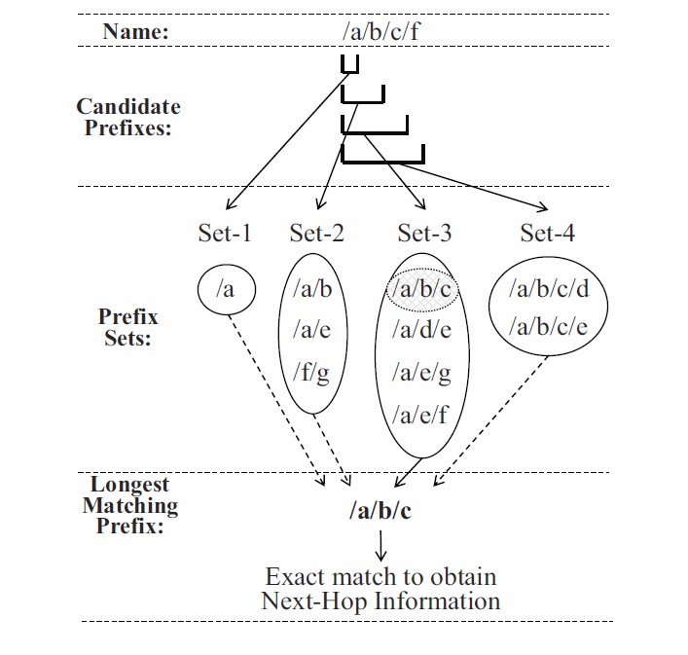

Slide 7
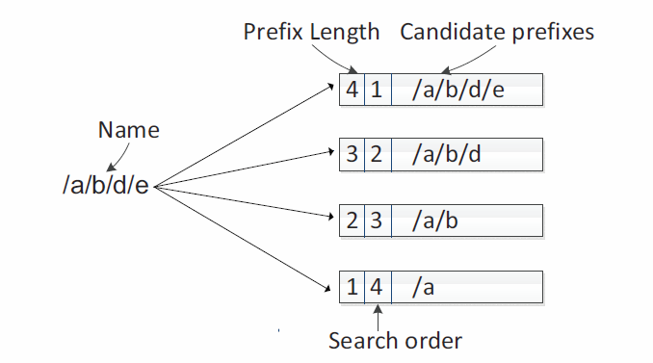
The optimal linear search scheme
The search process of an address can be terminated when the lookup engine finds the longest matching prefix.
Probing the prefixes in a descending order is simple and it is the optimal linear search path for the original FIB.

Slide 8
Binary search scheme
To further shorten the search path of hash-based LPM, Waldvogel et al. break through the linear search by reconstructing the FIB data structure to add correlation among different prefixes sets.
With the help of the reconstructed FIB, the lookup engine can search the longest matching prefix in the random mode.
One of the most effective algorithm is the binary search algorithm that needs O(logN) probes to find the longest matching prefix on average

Slide 9
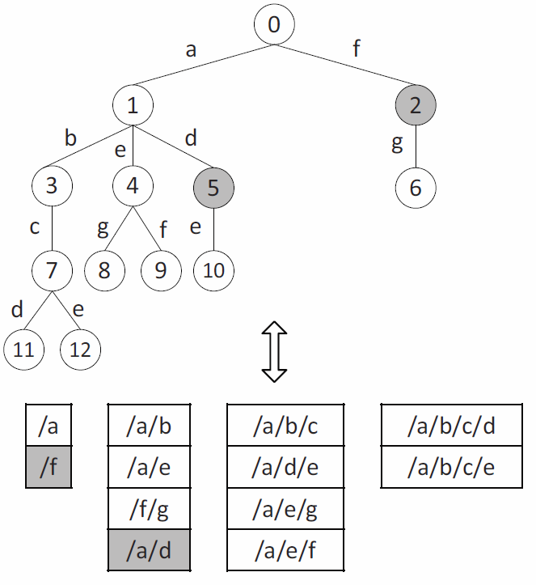
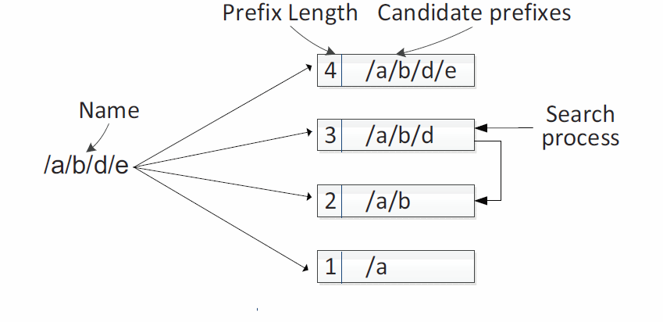

Slide 10
The statistical optimal search scheme
Since the length distribution of prefixes in the routing table is known in advance, there should be an optimal search path for each address.
The number of prefix sets is no greater than N, therefore even in the worst case we can find the optimal search path of an address by applying exhaustive search that has O(N!) time complexity.
we design and implement a dynamic programming algorithm only with O($N^{3}$) time complexity to find the optimal search path.

Slide 11
Dynamic Programming Algorithm For Optimizing LPM
Assuming that the prefixes in the reconstructed FIB are partitioned into N prefix sets.
$C_{ij}$ is the number of probes in the optimal search path from ${Set}_{i}$ to ${Set}_{j}$; ${PRE}_{k}$is the candidate prefix with k components; $P_{i}$ is the matching probability of ${Set}_{i}$ in the original FIB; and ${P′}_{i}$ is the matching probability of ${Set}_{i}$ in the reconstructed FIB.
The optimal search path of an address is equivalent to finding the minimal $C_{1M}$, if M <N; or the minimal $C_{1N}$, if M ≥ N. Here M is the length of the name or the IP address.

Slide 12
The problem of finding the minimal $C_{ij}$ can be decomposed into two optimization sub-problems: $C_{i(k−1)}$ and $C_{\left(k+1\right)j}$ . i ≤ k ≤ j; and $C_{ij}=0$, if i > j.
As the reconstructed FIB supports random search, we suppose the candidate prefix ${PRE}_{k}$ with k components will be checked at first.
If ${PRE}_{k}$ is dismatched, the length of the longest matching prefix will be less than k, and the lookup engine will search from ${PRE}_{i}$ to ${PRE}_{k−1}$ to lookup the exact longest matching prefix, i.e., to find the minimal $C_{i(k−1)}$;

Slide 13
Otherwise ${PRE}_{k}$ is matched, the length of the longest matching prefix will be k or greater than k, and the lookup engine will search from ${PRE}_{k+1}$ to ${PRE}_{j}$ to lookup the exact longest matching prefix, i.e., to find the minimal $C_{\left(k+1\right)j}$.
Therefore, the minimal $C_{ij}$ can be calculated in the following formula:
Here, 1 ≤ i ≤ N, 1 ≤ i ≤ N, i ≤ k ≤ j and $C_{ii}$ = 1 according to Formula (1). By storing the solution of sub-problem (e.g., $C_{ij}$), the optimal search path $C_{1N}$ is solved bottom-up.

Slide 14
We assume the access probability of each prefix in the original FIB is equal, i.e., $P_{i}={Set}_{i}/N$, here ${|Set}_{i}|$ is the number of prefixes in ${Set}_{i}$.
The dynamic programming algorithm recalculates the matching probability $P_{i}$ of ${Set}_{i}$ in the reconstructed FIB based on the matching probability $P_{i}$ in the original probability. Given that the meta-prefixes of a prefix is inserted into the reconstructed FIB, there is $P_{i}= \sum_{k=i}^{N}{P_{k}}$.
For example, in Figure 5, the original $P_{i}$ (i from 1 to 4) are {0.1, 0.3, 0.4, 0.2}. Consequently, we can calculate $P_{i}$= {1, 0.9, 0.6, 0.2}.

Slide 16
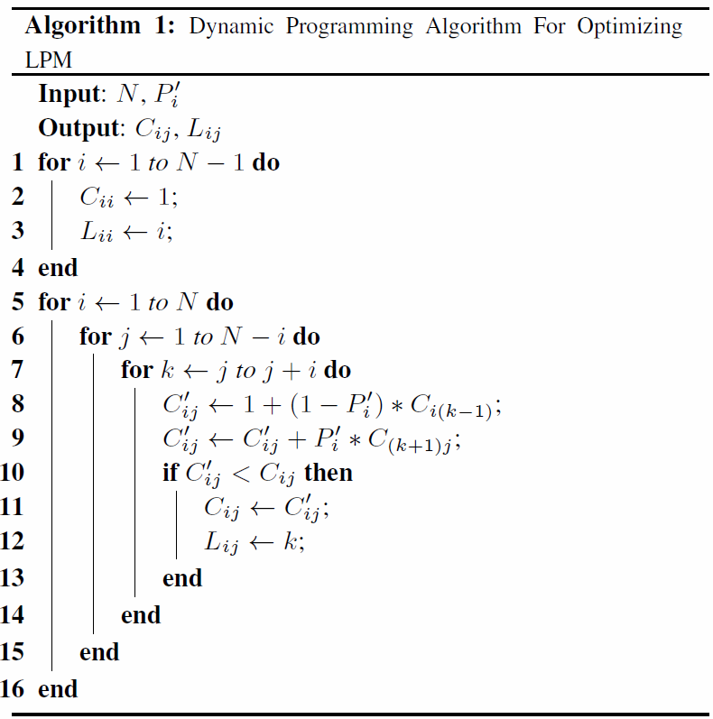
The dynamic programming algorithm, described in Algorithm 1, reduces the time complexity of finding the optimal search path from O(N!) to O($N^{3}$) compared with the exhaustive search.
for j = i+1 to N
for k = i to j

Slide 17
For example, there are two feasible ways to calculate $C_{34}$, Path-1: < $L_{33}$ → $L_{44}$ > or Path-2: < $L_{44}$→ $L_{33}$ >.
In Path-1, the prefix with 4 components ($L_{44}$) will be probed if and only if the prefix with 3 components ($L_{33}$) is matched. Therefore (choose k = 3),
$$C_{path1}=1+\left(1−{P^{′}}_{3}\right)∗C_{32}+{P^{′}}_{3}∗C_{44}=1+0+0.6∗1=1.6$$
On the other side, in Path-2, the prefix with 3 components ($L_{33}$) will be probed if and only if the prefix with 4 components ($L_{44}$) is dismatched. Hence(k = 4),
$$C_{path2}=1+\left(1−{P^{′}}_{4}\right)∗C_{33}+{P^{′}}_{4}∗C_{54}=1+0.4∗1+0=1.4$$
Consequently, the Paht-1 is chosen as the optimal search path, and there are $C_{34}=1.6$ and $L_{34}=3$.

Slide 18
C Matrix and L matrix
$$C_{ij}$$
$$L_{ij}$$
$$j$$
$$j$$
4 | 2.04 | 2 | 1.6 | 1
2 | 1.44 | 1.4 | 1
2 | 1.1 | 1
1 | 1
 | 1 | 2 | 3 | 4
4 | 3 | 3 | 3 | 4
2 | 3 | 3 | 3
2 | 2 | 2
1 | 1
 | 1 | 2 | 3 | 4
$$i$$
$$i$$

Slide 19
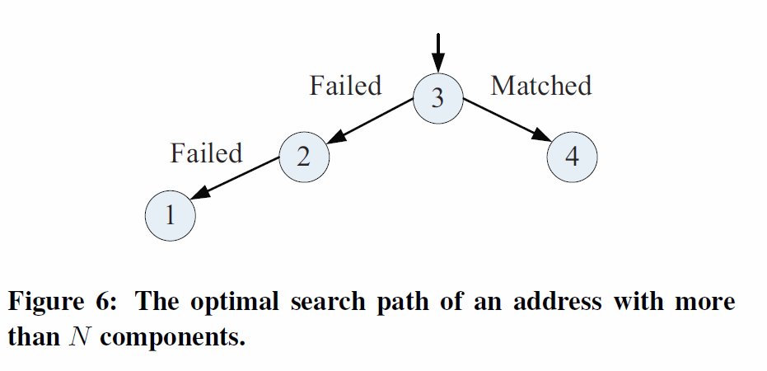

Slide 20
EXPERIMENTAL RESULTS
We combine the NameFilter with the 3 LPM search schemes introduced in Section 3 to increase the name lookup speed in NDN. Totally 4 methods are implemented. [NDN]
The average search path lengths of the 4 methods on the IP tables of Sydney and Oregon under the Chicago trace are listed in Table 5. [IP lookup]

Slide 21
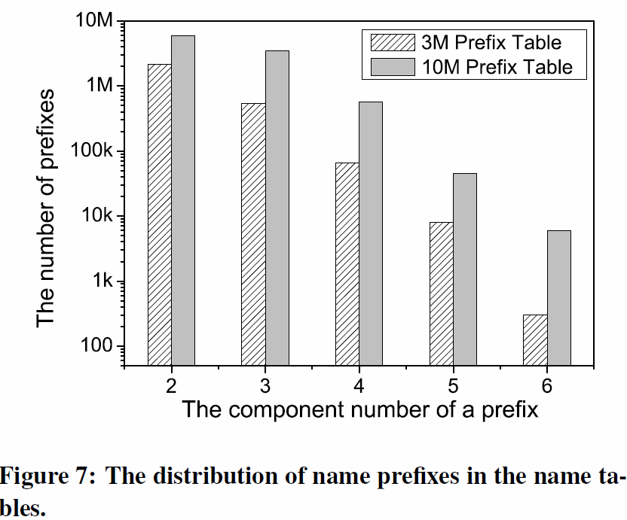
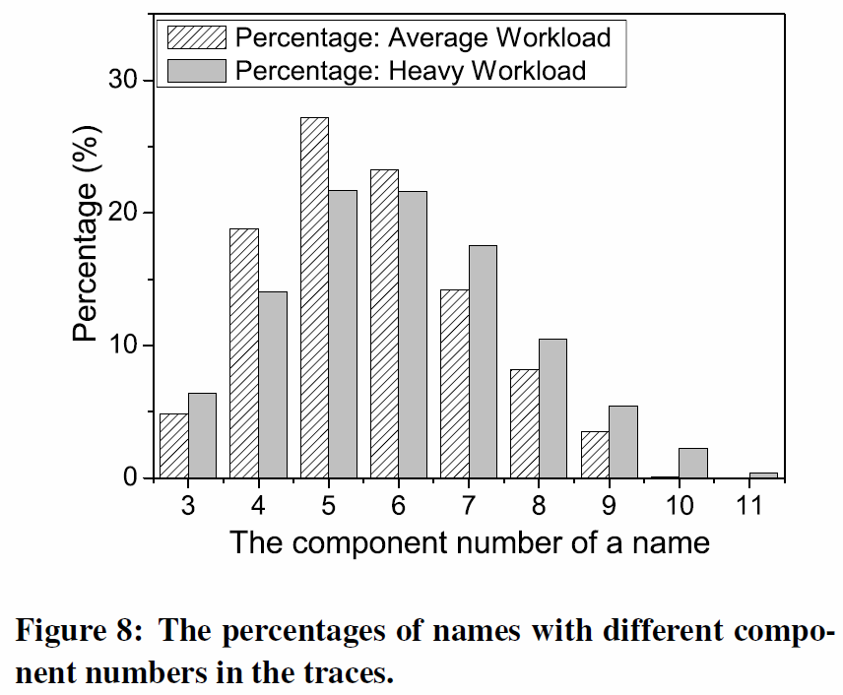

Slide 22
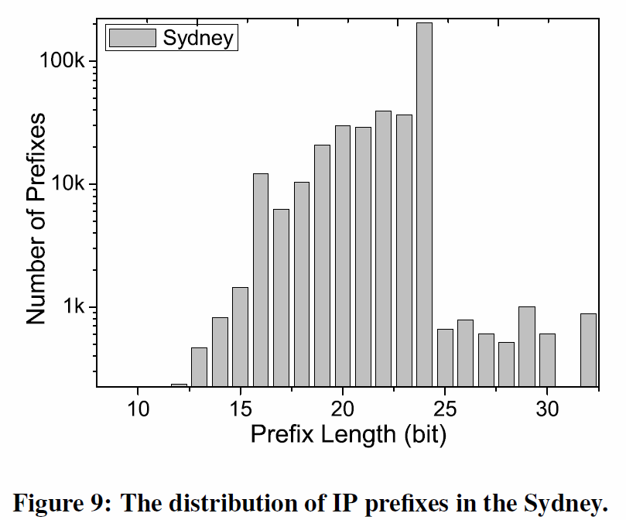
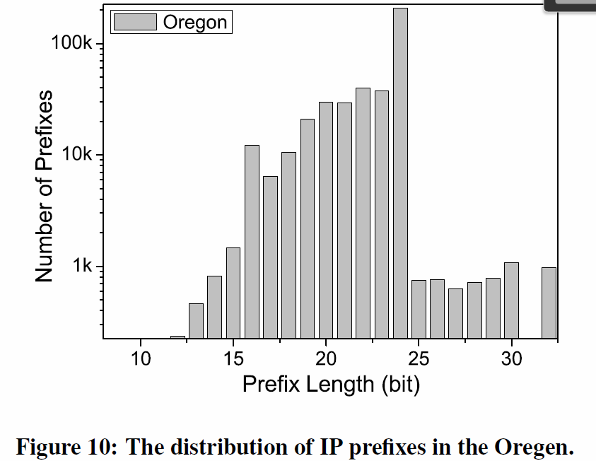

Slide 23
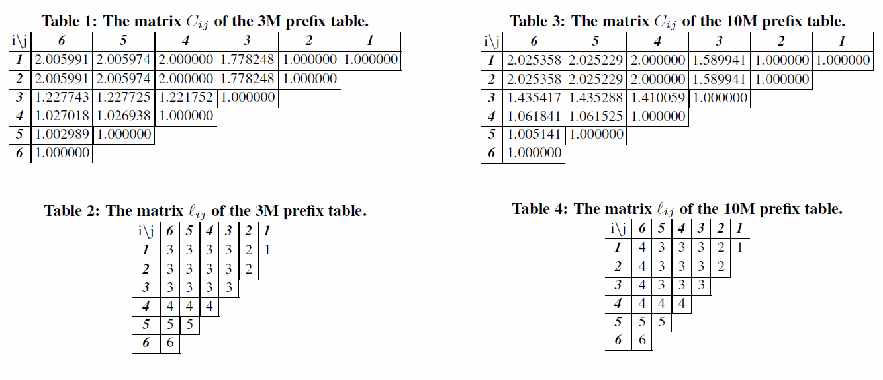

Slide 24
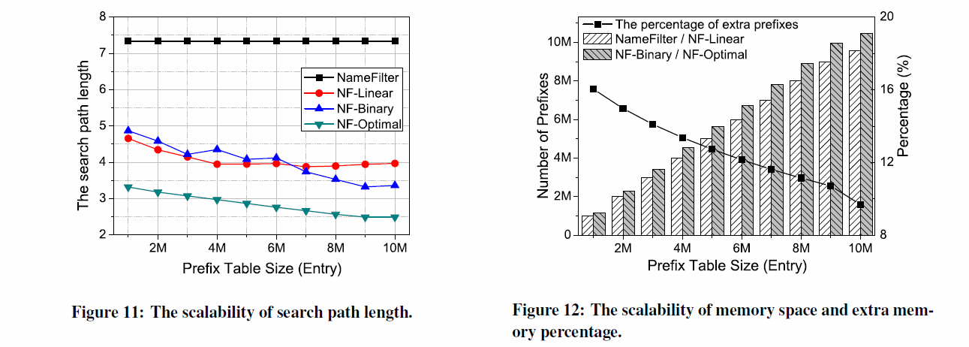

Slide 26
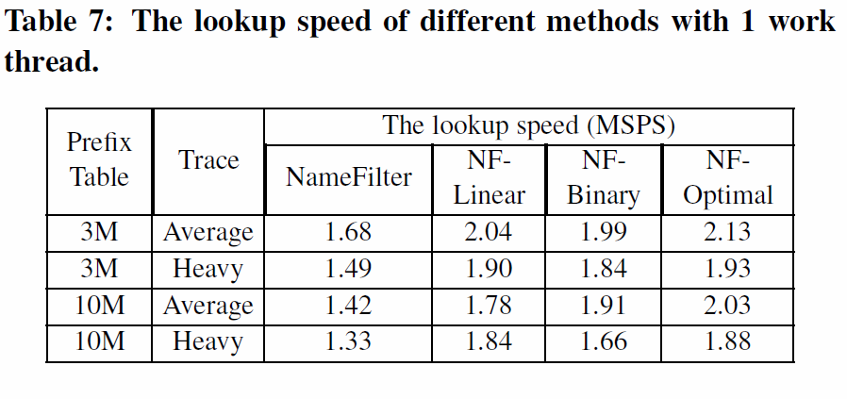
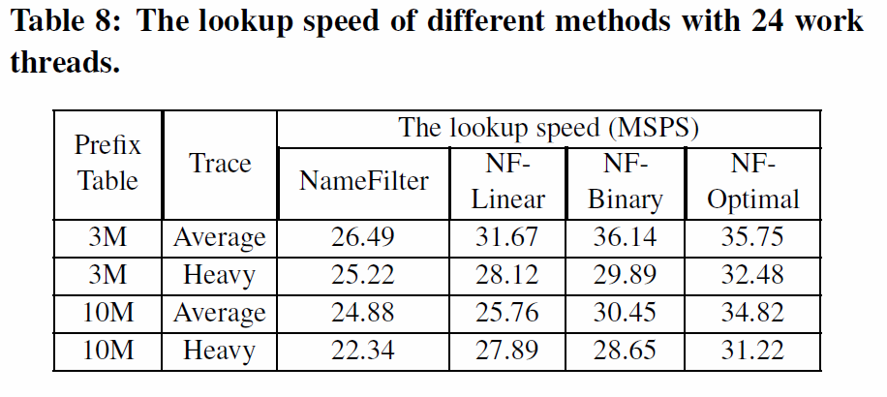

Slide 27
